Slide 1




Project
NLP Prodect Review

Slide 2
Team Members
▪︎ Alhanouf Aljamaan
▪︎ Dana AlOmari

Slide 3
Introduction
Online customer reviews contain valuable feedback.
Manually analyzing thousands of reviews is time-consuming and inefficient.
This project leverages Natural Language Processing (NLP) to automate review analysis.

Slide 4

System Overview
This project is composed of three core modules:
BERT
BART
KMeans.
Sentiment Classification
Clustering
Summarization

Slide 5
Preprocessing Dataset
Standardizing text
Removing null values
01
02
Mapping star ratings sentiment
Key columns: review text rating
04
03

Slide 6
Sentiment Classification
positive
BERT
Model
NEUTRAL
NEGATIVE

Slide 7
Negative Neutral Positive
precision 0.8785 0.7613 0.8198
Recall 0.8207 0.8124 0.8075
F1 - Score 0.8486 0.7860 0.8136

Slide 8
Product Category Clustering
Focused on the categories column from dataset.
Used MiniLM for embeddings.
Applied Kmeans with 6 clusters.
Checked quality with Silhouette Score : 0.2178378850221634.
Manually labeled clusters.
Added Cluster_Category column in the dataset.

Slide 9
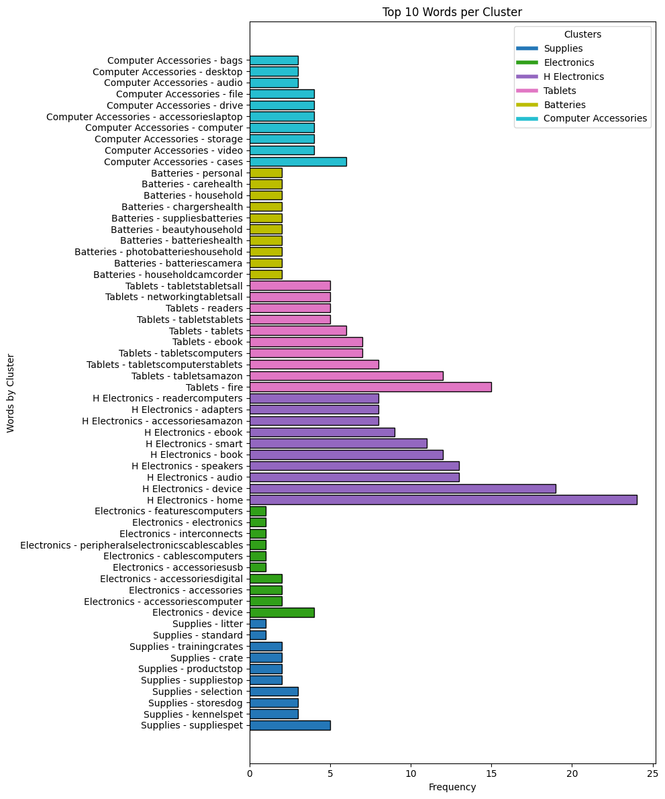
Clustering Result
We grouped products into 6 main clusters:
Supplies
Electronics
H Electronics
Tablets
Batteries
Computer Accessories

Slide 10
NLP Models and Summarization for Product Reviews
BART: Extracts key sentences (fast and accurate).
T5: Generates blog-style summaries (more creative).
GPT-4: Deep understanding, great for storytelling.
Summarization Process:
Combined first 10 reviews per product
Used facebook/bart-large-cnn with HuggingFace
Output: 30–150 word summaries
Final Output Includes:
Top 3 Products
Key Complaints
Worst Product to Avoid

Slide 11
Gradio Deployment

Slide 12
Thank You!
Any Questions ?

